Slide 1

Stack and Queue
SoftUni Team
Technical Trainers
Software University
https://softuni.bg

Slide 2
Have a Question?
sli.do
#java-advanced

Slide 3
Table of Contents
Stack - Last In First Out (LIFO)
Stack Functionality
Java Stack Implementation
Overview of All Operations
Queue - First In First Out(FIFO)
Queue Functionality
Queue Implementation
Overview of All Operations
Priority Queue

Slide 4
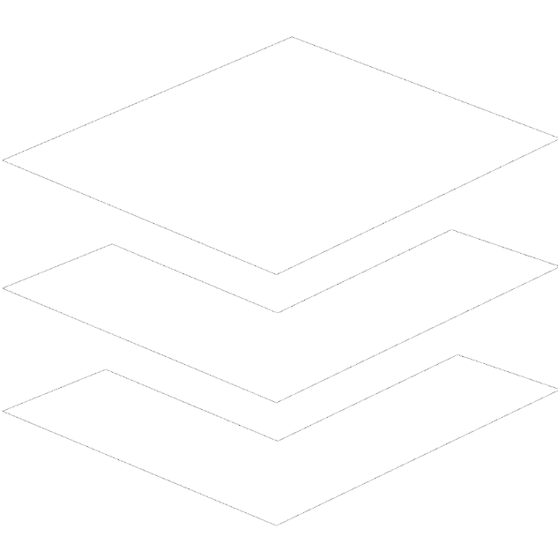
Stack

Slide 5
Stack Functionality
Stacks provide the following functionality:
Pushing an element at the top of the stack
Popping element from the top of the stack
Getting the topmost element without removing it
10
10
10
5
5
5
2
2
2
Push
Pop
Peek
5

Slide 6
ArrayDeque<E> – Java Stack Implementation
Creating a Stack
Adding elements at the top of the stack
Removing elements
Getting the value of the topmost element
ArrayDeque<Integer> stack = new ArrayDeque<>();
stack.push(element);
Integer element = stack.pop();
Integer element = stack.peek();

Slide 7
Stack – Utility Methods
ArrayDeque<Integer> stack = new ArrayDeque<>();
int size = stack.size();
boolean isEmpty = stack.isEmpty();
boolean exists = stack.contains(2);

Slide 8
Stack – Overview of All Operations
10
5
5
2
15
-7
132
Stack<Integer>
push()
2
0
1
3
4
pop()
size():
5
5
peek()

Slide 9
Problem: Browser History
Write a program which takes 2 types of browser instructions:
Normal navigation: a URL is set, given by a string
The string "back" that sets the current URL to the last set URL
Input
Output
https//softuni.bg/
back
https//softuni.bg/trainings/courses
back
https//softuni.bg/trainings/2056
back
https//softuni.bg/trainings/live
https//softuni.bg/trainings/live/details
Home
https//softuni.bg/
no previous URLs
https//softuni.bg/trainings/courses
https//softuni.bg/
https//softuni.bg/trainings/2056
https//softuni.bg/
https//softuni.bg/trainings/live
https//softuni.bg/trainings/live/details

Slide 10
Solution: Browser History (1)
Scanner scanner = new Scanner(System.in);
ArrayDeque<String> browser = new ArrayDeque<>();
String line = scanner.nextLine();
String current = "";
// continue…
Check your solution here: https://judge.softuni.bg/Contests/1437/Stacks-and-Queues-Lab
10

Slide 11
Solution: Browser History (2)
while(!line.equals("Home")) {
if(line.equals("back")) {
if(!browser.isEmpty()) { current = browser.pop();
} else {
System.out.println("no previous URLs");
line = scanner.nextLine();
continue; }
} else {
if(!current.equals("")) { browser.push(current); }
current = line; }
System.out.println(current);
line = scanner.nextLine(); }
11

Slide 12
Problem: Simple Calculator
Implement a simple calculator that can evaluate simple expressions (only addition and subtraction)
Input
Output
2 + 5 + 10 - 2 - 1
14
2 - 2 + 5
5
Check your solution here: https://judge.softuni.bg/Contests/1437/Stacks-and-Queues-Lab

Slide 13
Solution: Simple Calculator (1)
Scanner scanner = new Scanner(System.in);
String[] tokens = scanner.nextLine().split("\\s+");
Deque<String> stack = new ArrayDeque<>();
Collections.addAll(stack, tokens);
// continues…
Split by regex
Adds a collection to another collection
Check your solution here: https://judge.softuni.bg/Contests/1437/Stacks-and-Queues-Lab

Slide 14
Solution: Simple Calculator (2)
while (stack.size() > 1) {
int first = Integer.valueOf(stack.pop());
String op = stack.pop();
int second = Integer.valueOf(stack.pop());
switch (op)
case "+": stack.push(String.valueOf(first + second));
break;
case "-": stack.push(String.valueOf(first - second));
break;
}
System.out.println(stack.pop());
Check your solution here: https://judge.softuni.bg/Contests/1437/Stacks-and-Queues-Lab

Slide 15
Problem: Decimal to Binary Converter
Create a converter which takes a decimal number and converts it into a binary number
Input
Output
10
1010
1024
10000000000
Check your solution here: https://judge.softuni.bg/Contests/1437/Stacks-and-Queues-Lab

Slide 16
Solution: Decimal to Binary Converter
Scanner scanner = new Scanner(System.in);
int decimal = Integer.valueOf(scanner.nextLine());
ArrayDeque<Integer> stack = new ArrayDeque<>();
// TODO: check if number is 0
while (decimal != 0)
stack.push(decimal % 2);
decimal /= 2;
while (!stack.isEmpty())
System.out.print(stack.pop());
Check your solution here: https://judge.softuni.bg/Contests/1437/Stacks-and-Queues-Lab
16

Slide 17
Problem: Matching Brackets
We are given an arithmetical expression with brackets (with nesting)
Goal: extract all sub-expressions in brackets
1 + (2 - (2 + 3) * 4 / (3 + 1)) * 5
(2 + 3)
(3 + 1)
(2 - (2 + 3) * 4 / (3 + 1))
Check your solution here: https://judge.softuni.bg/Contests/1437/Stacks-and-Queues-Lab

Slide 18
Solution: Matching Brackets (1)
Scanner scanner = new Scanner(System.in);
String expression = scanner.nextLine();
Deque<Integer> stack = new ArrayDeque<>();
// continue…
Check your solution here: https://judge.softuni.bg/Contests/1437/Stacks-and-Queues-Lab

Slide 19
Solution: Matching Brackets (2)
for (int i = 0; i < expression.length(); i++) {
char ch = expression.charAt(i);
if (ch == '(')
stack.push(i);
else if (ch == ')')
int startIndex = stack.pop();
String contents = expression.substring(startIndex, i + 1);
System.out.println(contents);
}
Check your solution here: https://judge.softuni.bg/Contests/1437/Stacks-and-Queues-Lab

Slide 20

Queues

Slide 21
Queue
First In First Out
2
5
10

Slide 22
Queue – Abstract Data Type
Queues provide the following functionality:
Adding an element at the end of the queue
Removing the first element from the queue
Getting the first element of the queue without removing it
2
5
10
2
5
10
2
5
10

Slide 23
ArrayDeque<E> – Java Queue Implementation (1)
Creating a Queue
Adding elements at the end of the queue
add() – throws exception if queue is full
offer() – returns false if a queue is full
ArrayDeque<Integer> queue = new ArrayDeque<>();
queue.add(element);
queue.offer(element);

Slide 24
ArrayDeque<E> – Java Queue Implementation (2)
Removing elements
remove() - throws exception if queue is empty
poll() - returns null if queue is empty
Check first element
element = queue.remove();
element = queue.poll();
element = queue.peek();

Slide 25
Add() / Offer()
Adds an element to the queue
4
2
3
1
Queue<Integer>
size():
0
-3
15
121
5

Slide 26
Remove() / Poll()
Returns and removes first element
4
2
size():
3
Queue<Integer>
121
15
-3
5

Slide 27
Problem: Hot Potato
Children form a circle and pass a hot potato clockwise
Every n^{th} toss a child is removed until only one remains
Upon removal the potato is passed forward
Print the child that remains last
Input
Output
Sam John Sara
2
Removed John
Removed Sam
Last is Sara
Check your solution here: https://judge.softuni.bg/Contests/1437/Stacks-and-Queues-Lab

Slide 28
Solution: Hot Potato (1)
Scanner scanner = new Scanner(System.in);
String[] children = scanner.nextLine().split("\\s+");
int n = Integer.valueOf(scanner.nextLine());
ArrayDeque<String> queue = new ArrayDeque<>();
for (String child : children)
queue.offer(child);
// continue…
Check your solution here: https://judge.softuni.bg/Contests/1437/Stacks-and-Queues-Lab

Slide 29
Solution: Hot Potato (2)
while (queue.size() > 1) {
for (int i = 1; i < n; i++)
queue.offer(queue.poll());
System.out.println("Removed " + queue.poll());
}
System.out.println("Last is " + queue.poll());
Check your solution here: https://judge.softuni.bg/Contests/1437/Stacks-and-Queues-Lab

Slide 30
ArrayDeque<E> – Java Queue Implementation (3)
Utility Methods
peek() - checks the value of the first element
size() - returns queue size
toArray() - converts the queue to an array
contains() - checks if element is in the queue
Integer element = queue.peek();
Integer size = queue.size();
Integer[] arr = queue.toArray();
boolean exists = queue.contains(element);

Slide 31
Peek()
Gets the first element without removing it
size():
2
Queue<Integer>
121
15
15

Slide 32
Queue – Overview of All Operations
4
0
1
2
size():
3
Queue<Integer>
-3
15
121
15
5
5
add()
peek()
remove()

Slide 33
Priority Queue
Retains a specific order to the elements
Higher priority elements are pushed to the beginning of the queue
Lower priority elements are pushed to the end of the queue
A
B
C

Slide 34
Problem: Math Potato
Rework the previous problem by using a PriorityQueue so that a child is removed only on a prime cycle (cycles start from 1)
If a cycle is not prime, just print the child's name
Input
Output
Maria Peter George
2
Removed George
Prime Maria
Prime Maria
Removed Maria
Last is Peter
Check your solution here: https://judge.softuni.bg/Contests/1437/Stacks-and-Queues-Lab

Slide 35
Solution: Math Potato
int cycle = 1;
while (queue.size() > 1) {
for (int i = 1; i < n; i++)
queue.offer(queue.poll());
if (isPrime(cycle))
System.out.println("Prime " + queue.peek());
else
System.out.println("Removed " + queue.poll());
cycle++;
}
System.out.println("Last is " + queue.poll());
Check your solution here: https://judge.softuni.bg/Contests/1437/Stacks-and-Queues-Lab

Slide 36

Summary
…
…
…
Stack - Last In First Out (LIFO)
push(), pop(), peek()
Queue - First In First Out (FIFO)
add(), poll(), peek()
Priority Queue

Slide 37
Questions?
Notes:
37

Slide 38














SoftUni Diamond Partners

Slide 39

Educational Partners

Slide 40
Trainings @ Software University (SoftUni)
Software University – High-Quality Education, Profession and Job for Software Developers
softuni.bg
Software University Foundation
softuni.foundation
Software University @ Facebook
facebook.com/SoftwareUniversity
Software University Forums
forum.softuni.bg
40
Notes:
40

Slide 41

License
This course (slides, examples, demos, exercises, homework, documents, videos and other assets) is copyrighted content
Unauthorized copy, reproduction or use is illegal
© SoftUni – https://about.softuni.bg
© Software University – https://softuni.bg
Notes:
41

